Slide 1
Final Graphs
File created on: 5/13/2019 6:20:53 PM

Slide 2
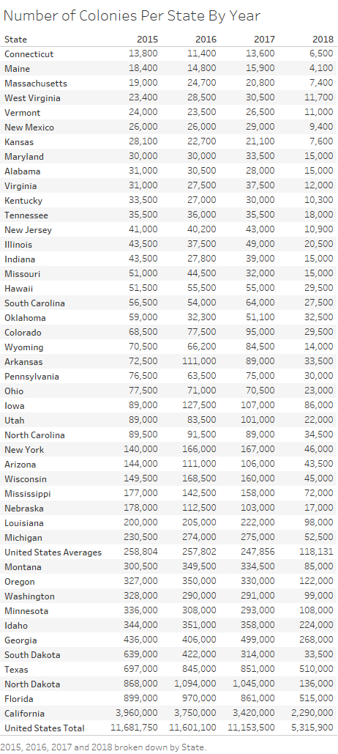

Slide 3
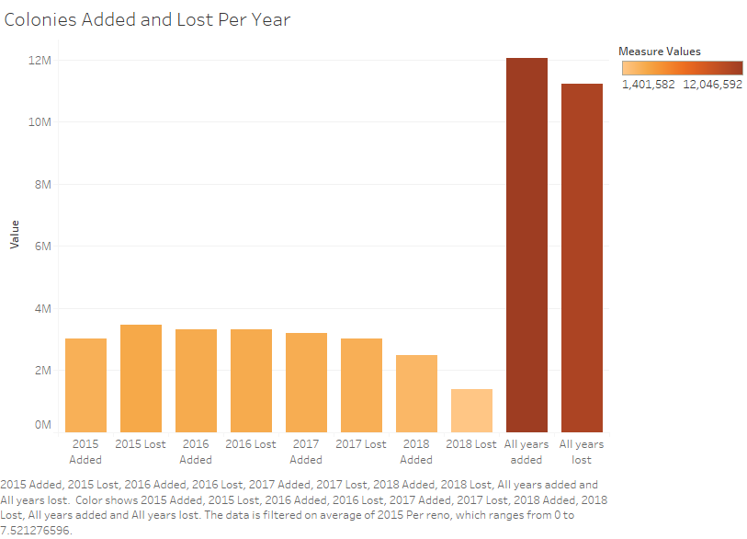

Slide 4
